Slide 1
TechFolios
Philip Johnson
Collaborative Software Development Laboratory
Information and Computer Sciences
University of Hawaii
Honolulu, HI USA

Slide 2
Why?

Slide 3
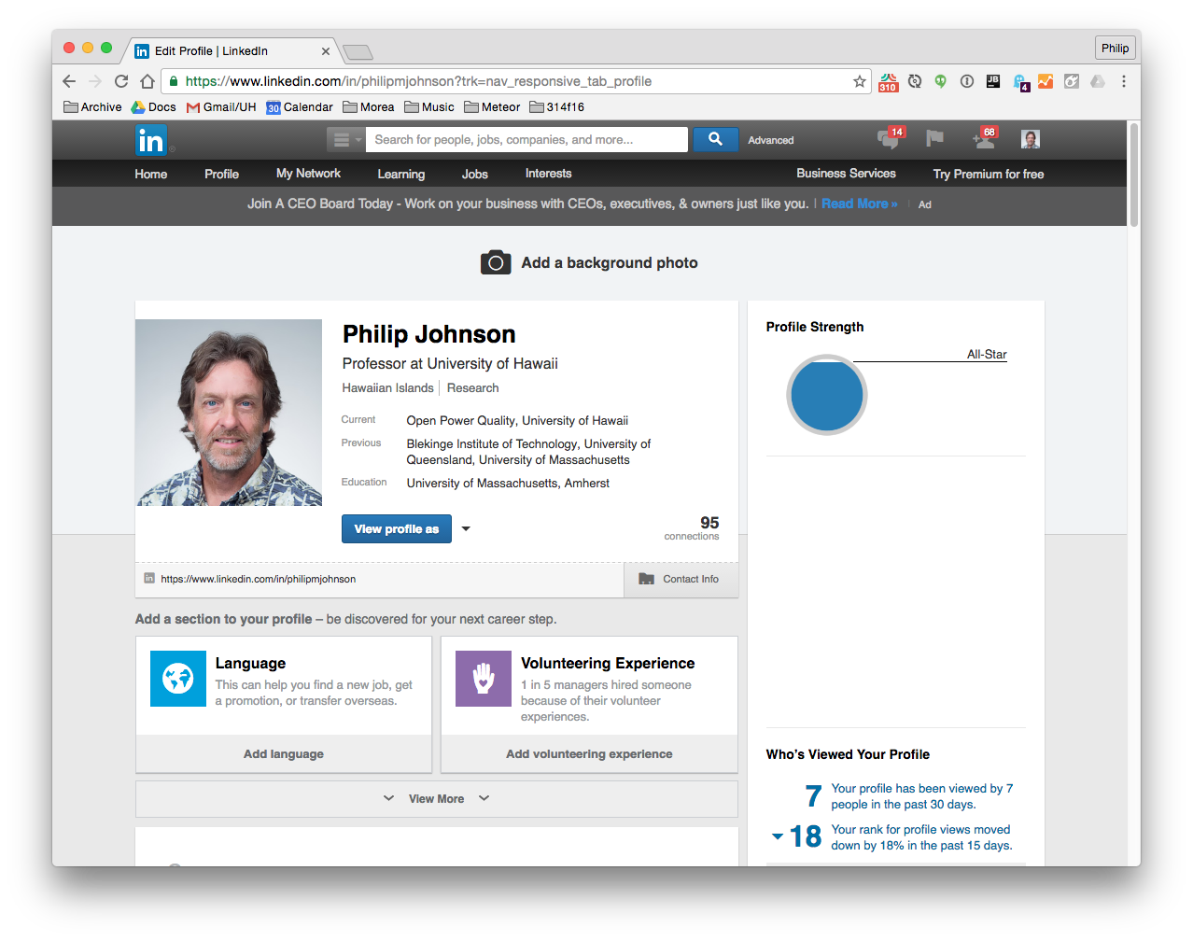

Slide 4
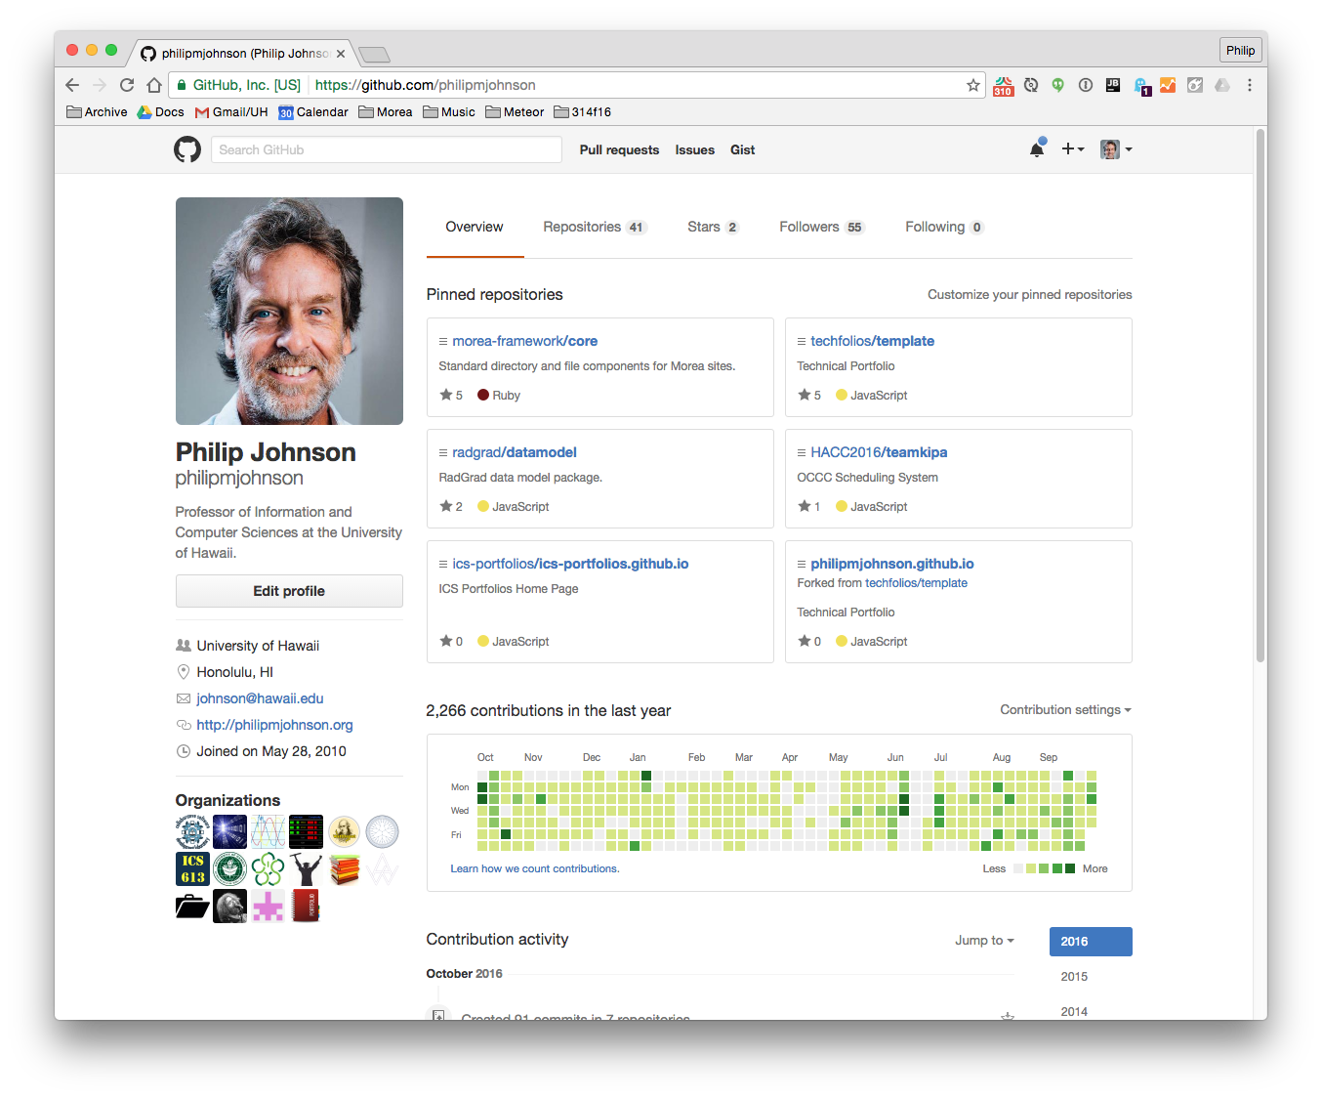

Slide 5
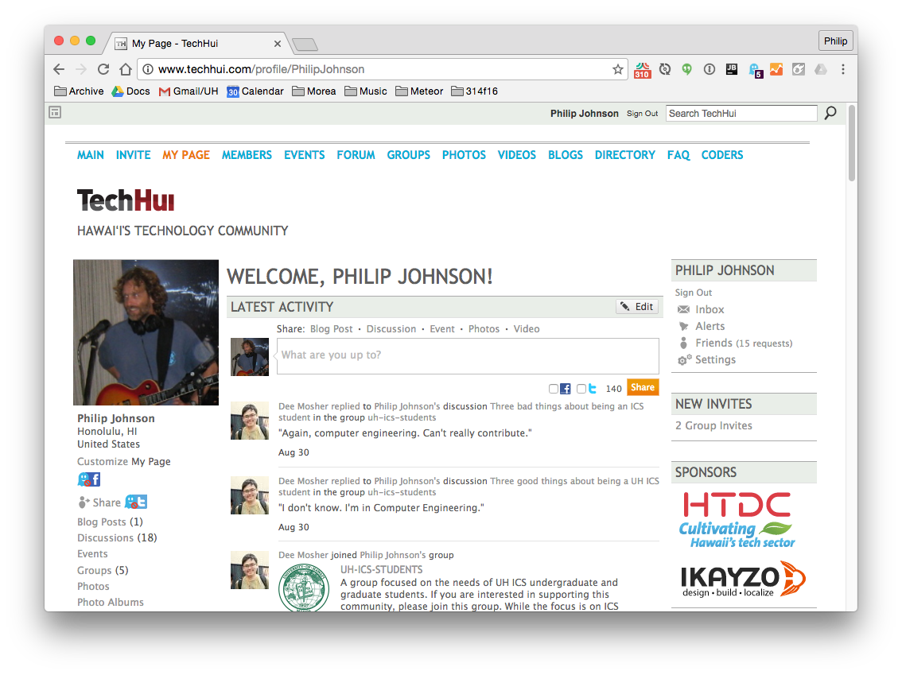

Slide 6
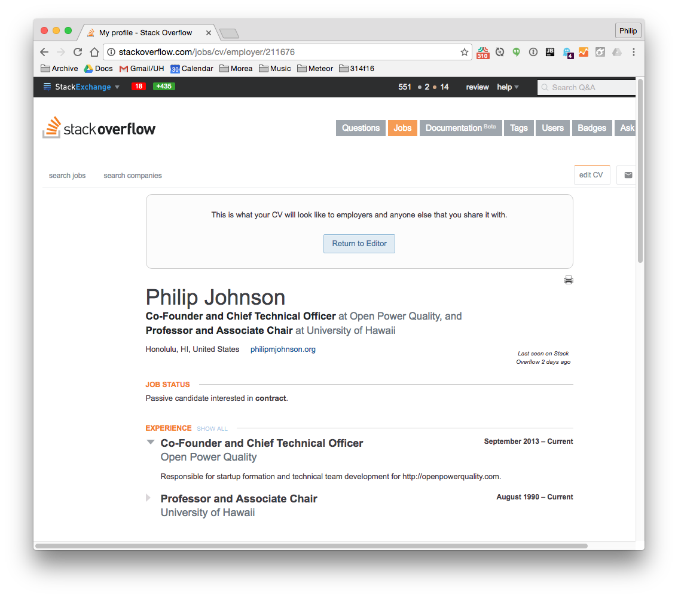

Slide 7
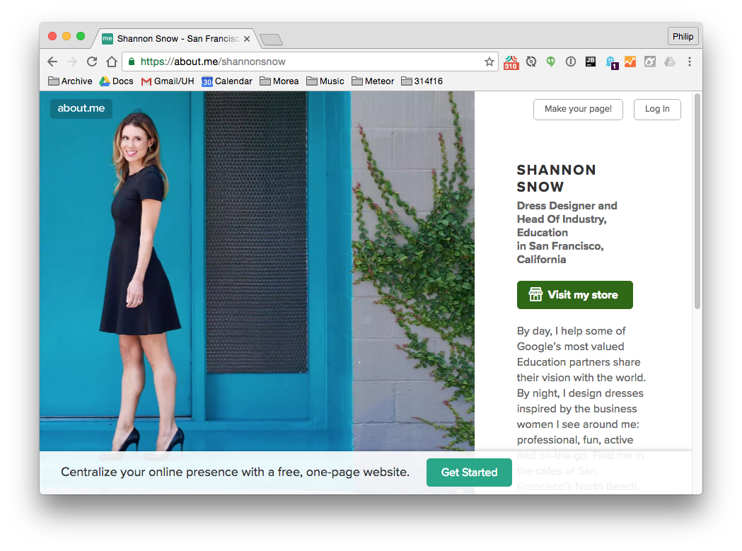

Slide 8
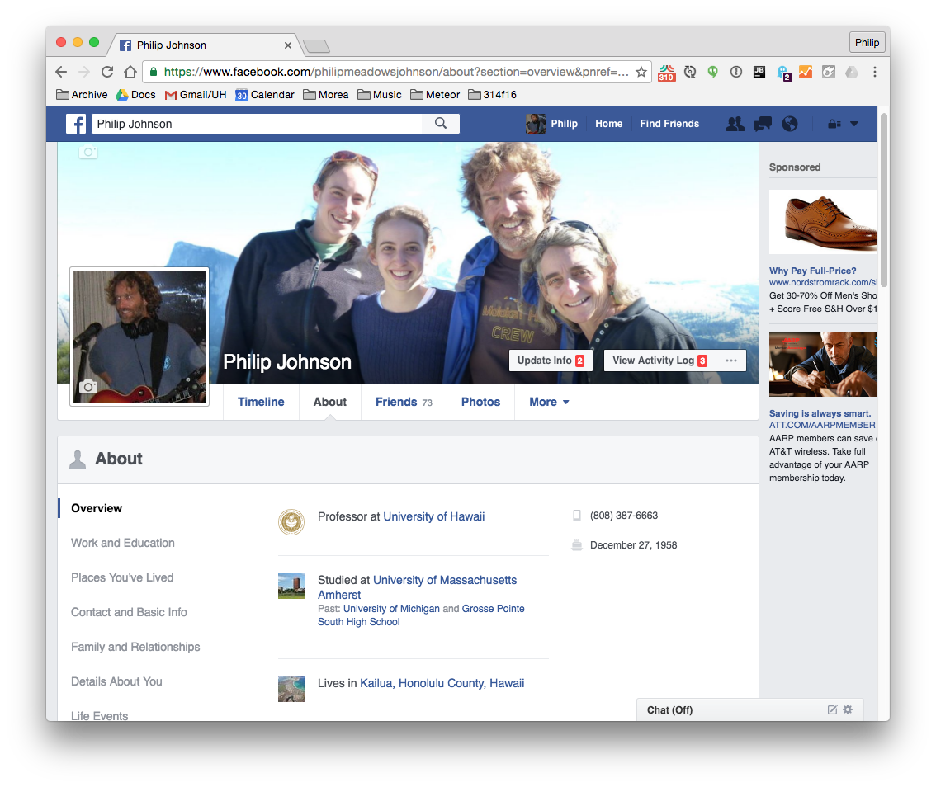

Slide 9
Problem 1:
These profiles are biased to the needs of their corporate overlords.
(Well, except for TechHui’s.)

Slide 10
Problem 2:
These profiles make students (and “young professionals”) look bad.

Slide 11
Solution (First try)

Slide 12
WordPress

Slide 13
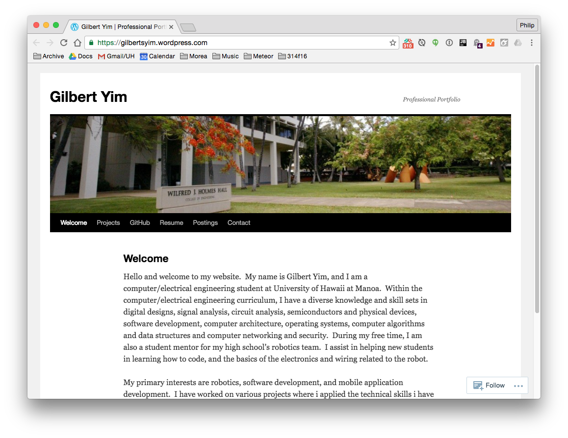

Slide 14
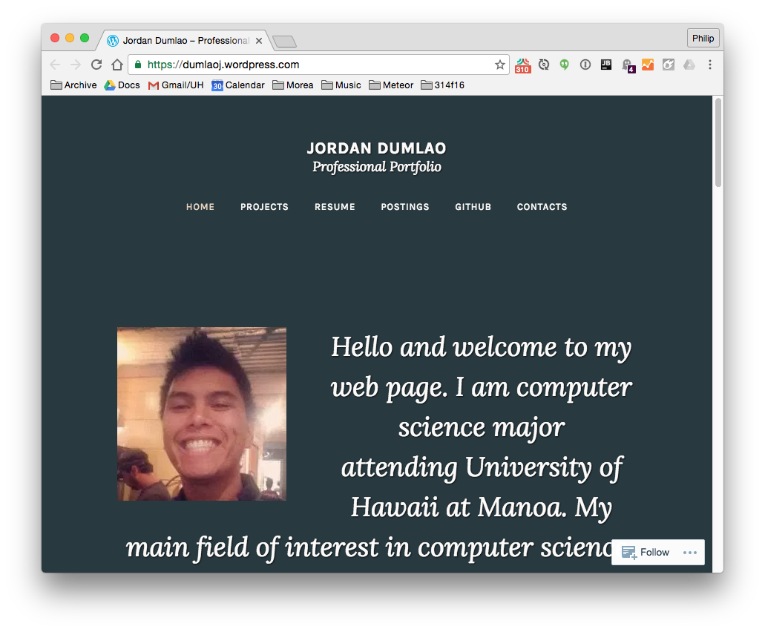

Slide 15
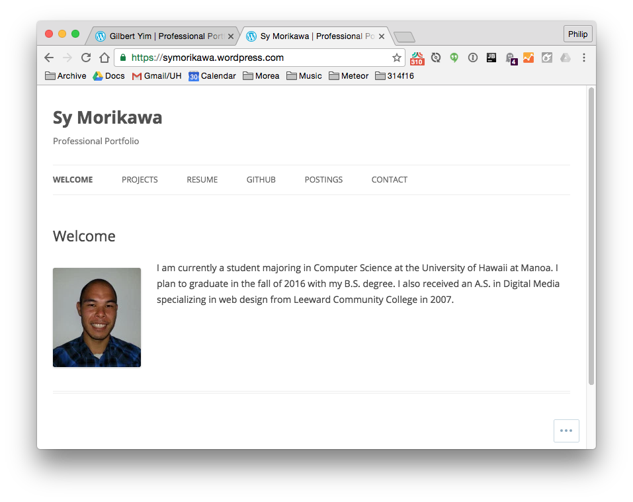

Slide 16
The problem with WordPress
Too easy to go off the rails.
“Portfolio” themes oriented toward photographers, not hackers.

Slide 17
Solution (Second try)

Slide 18
TechFolios

Slide 19



TechFolios =
+
+

Slide 20
How to use

Slide 21
1. Clone template 2. Edit details 3. Commit to username.github.io

Slide 22
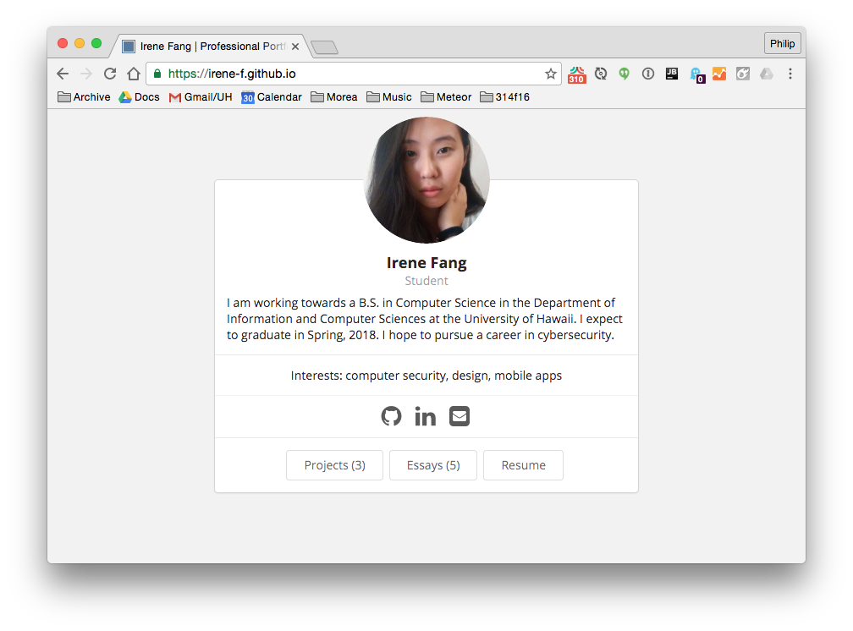

Slide 23
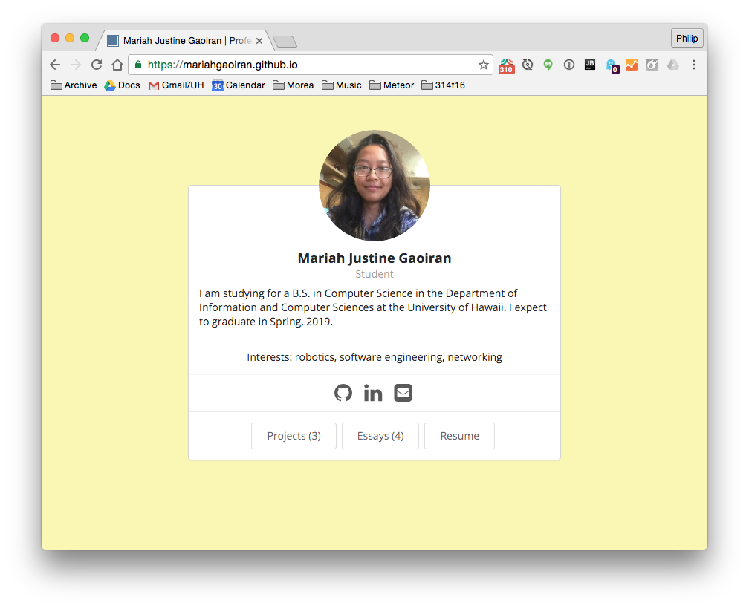

Slide 24
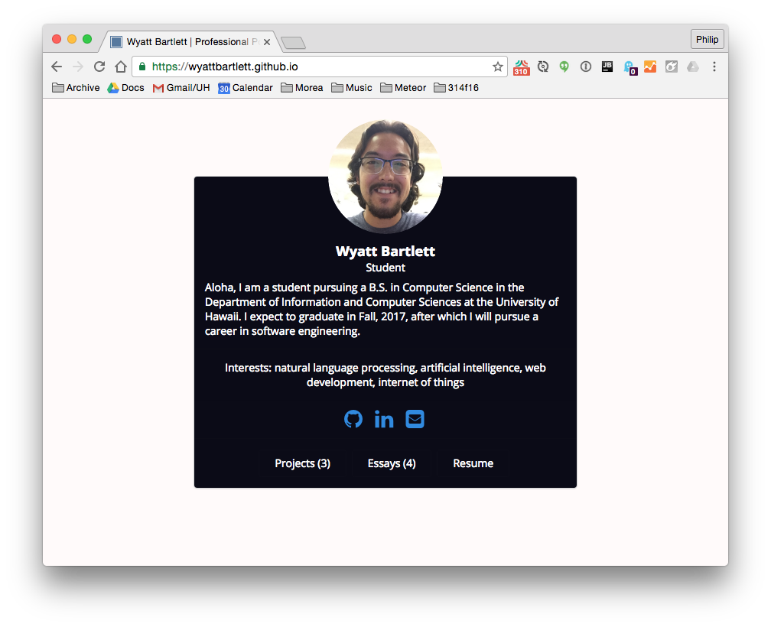

Slide 25
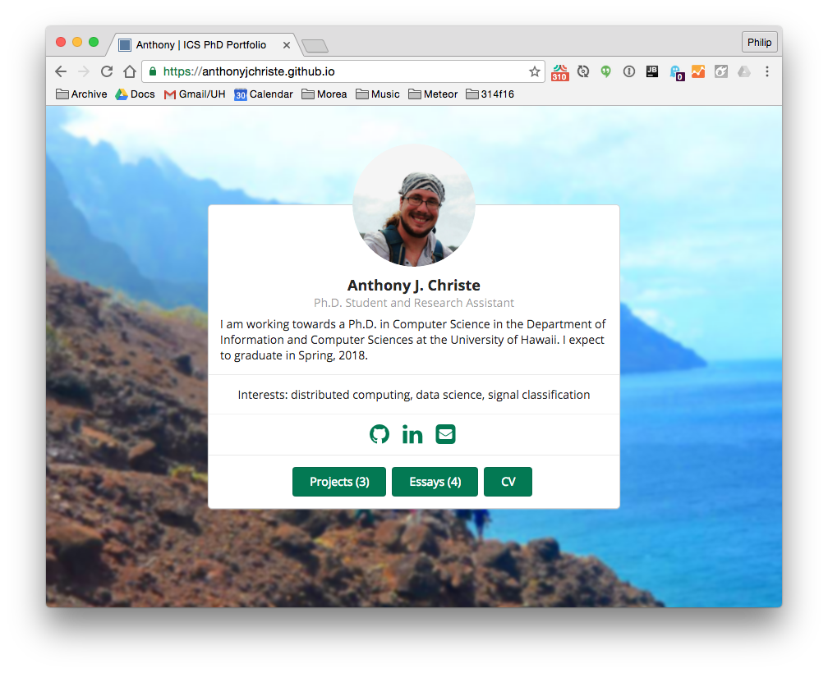

Slide 26
